Slide 1
Pandas
Lesson 4.1

Slide 2

The Big Picture
Python Unit
Python
Pandas
Matplotlib
APIs
Unit Assessment
Final Project
Project Design
Train Model & Build Database
Dashboards Presentation
Python Unit
Python
Pandas
Matplotlib
APIs
Unit Assessment
Visualization Unit
Web Scraping
Plotly
Leaflet
Tableau
Unit Assessment
01
03
05
02
06
02
04
Excel Unit
Excel
VBA
Unit Assessment
Databases Unit
SQL
ETL
SQLite
Unit Assessment
Advanced Topics Unit
R—Stats
Big Data—AWS
Machine Learning
Unit Assessment

Slide 3

Boot Camp Pointers
If you’re struggling with this module, remember that you have the following resources to help you:
Learning Assistants
Office Hours
Tutoring Services

Slide 4
This Week: Pandas
Module 4

Slide 5
This Week: Pandas
By the end of this week, you’ll know how to:
Read an external CSV file into a DataFrame.
Determine data types of row values in a DataFrame.
Format and retrieve data from columns of a DataFrame.
Merge, filter, slice, and sort a DataFrame.
Apply the groupby() function to a DataFrame.
Use multiple methods to perform a function on a DataFrame.
Perform mathematical calculations on columns of a DataFrame or Series.

Slide 6

This Week’s Challenge
Using the skills learned throughout the week, help a mock school board with their investigation by adjusting specific data.

Slide 7

Career Connection
How will you use this module’s content in your career?

Slide 8
How to Succeed This Week
Module 4

Slide 9

Quick Tip for Success:
New syntax may not always be easy to remember, but don’t worry! The documentation you need is just a click away.

Slide 10
Today’s Agenda
Module 4

Slide 11
Today’s Agenda
By completing today’s activities, you’ll learn the following skills:
01
Use a variety of Pandas methods and functions on a DataFrame
02
Merge DataFrames
03
Format DataFrame columns
Make sure you’ve downloaded any relevant class files!
Notes:
* Verify that they have installed Anaconda.
* Verify that they have created a working PythonData conda environment.
* Import and read a CSV into a DataFrame using Pandas
* Use a variety of Pandas methods and functions on a DataFrame
* Be able to merge two DataFrames
* Format values in DataFrame columns

Slide 12
How comfortable do you feel with this topic?

Slide 13
The pd.Series() function creates a one-dimensional array that has a numeric index of the initial list, which acts as a key in a dictionary.

Slide 14

Each Column in a DataFrame Is a Series
A DataFrame is a two-dimensional, labeled data structure, like a dictionary, with rows and columns of potentially different data types such as strings, integers, and floats, where data is aligned in a table, much like a spreadsheet.
DataFrames Series
row
column

Slide 15
What is the Pandas syntax for creating a Series?

Slide 16
Pandas Syntax for Creating a Series
01
Import Pandas library
02
Create a Series
First, import Pandas library running import pandas as pd.
This method of import allows Pandas functions/methods to be called using the variable pd.
To create a Series, simply run pd.Series() function and place a list within the parentheses. Note that the index for the values within the Series will be the numeric index of the initial list.

Slide 17
There Are Multiple Ways to Create DataFrames
Create DataFrames from scratch
Provide a dictionary of lists
One of many different ways to create DataFrames from scratch is to use the pd.DataFrame() function and provide it with a list of dictionaries. Each dictionary will represent a new row where the keys become column headers, and the values will be placed inside the table.
Another way to use pd.DataFrame() is to provide a dictionary of lists. The keys of the dictionary will be the column headers, and the listed values will be placed into their respective rows.

Slide 18
Creating DataFrames

Slide 19
DataFrame Functions

Slide 20
head() takes a DataFrame and shows only its first five rows of data.
This number can be increased or decreased by placing an integer within the parentheses.

Slide 21
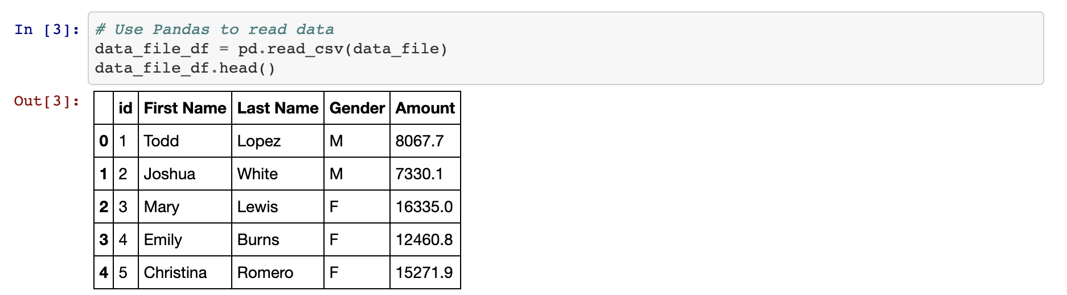
Built-in Function: head()
The head() method is helpful because it allows the programmer to look at a minified version of a much larger table, thus allowing them to make informed changes without having to search through the entire dataset.

Slide 22
describe() will print out a DataFrame containing summary statistics on the table and its columns. It also helpfully shows what other data functions can be performed on a DataFrame or Series.

Slide 23
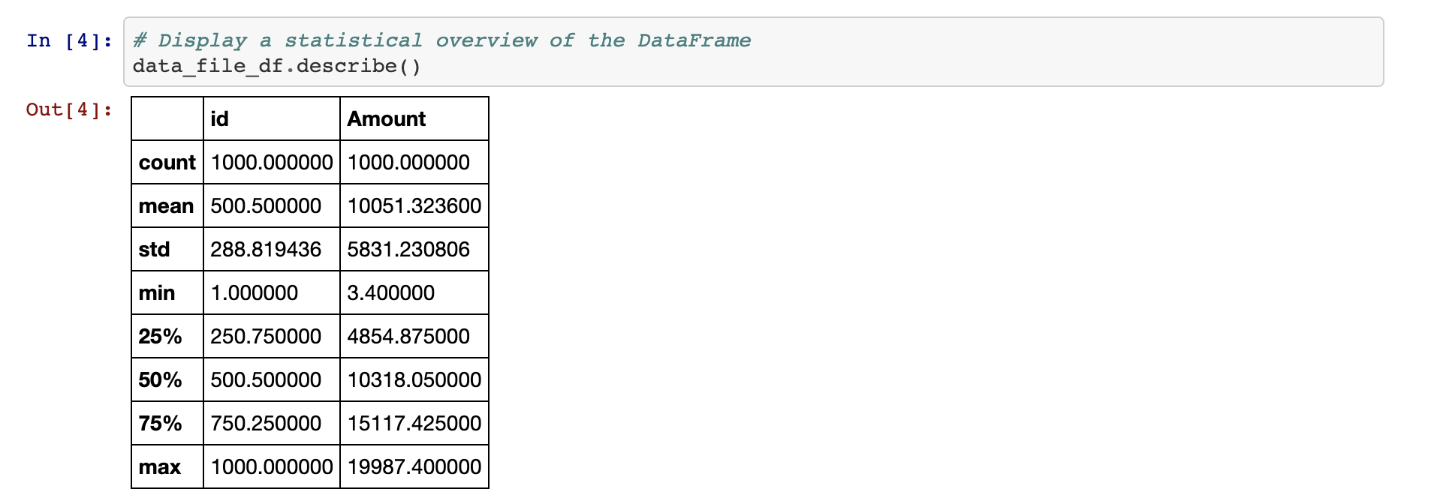
Built-in Function: describe()
The describe() method will print out a DataFrame containing some analytic information on the table and its columns. It also helpfully shows what other data functions can be performed on a DataFrame or Series.

Slide 24
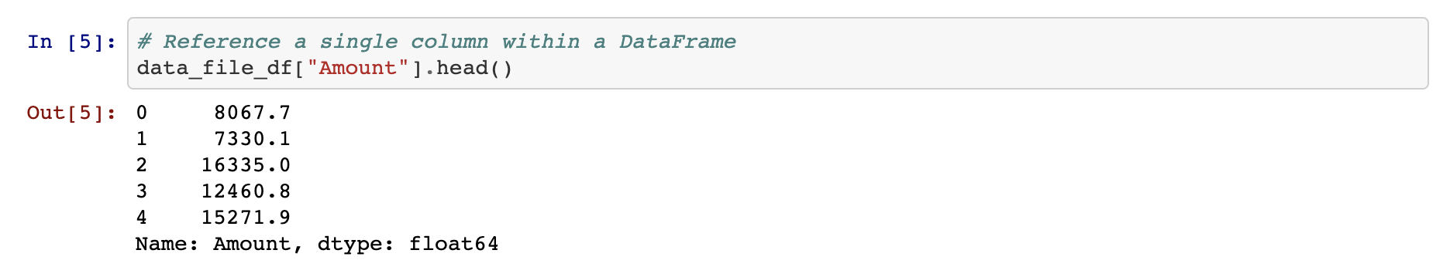
DataFrame Functions: Working With a Single Column
Most data functions can also be performed on a Series by referencing a single column within the whole DataFrame, like referencing a key within a dictionary.
In a DataFrame, we place the column header (i.e., “key”) in brackets, and the output contains the values under that column header.

Slide 25
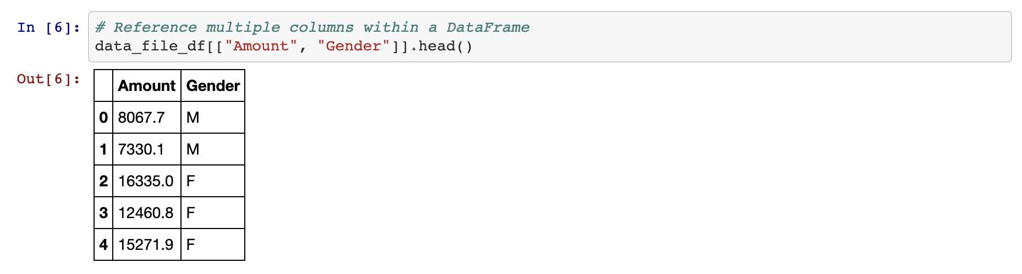
DataFrame Functions: Working With Multiple Columns
Multiple columns can be referenced, too, by placing all of the desired column headers within a pair of double brackets. To retrieve data from two or more columns, two sets of brackets must be used or Pandas will return an error.

Slide 26
unique() looks into a Series and returns all distinct values.

Slide 27
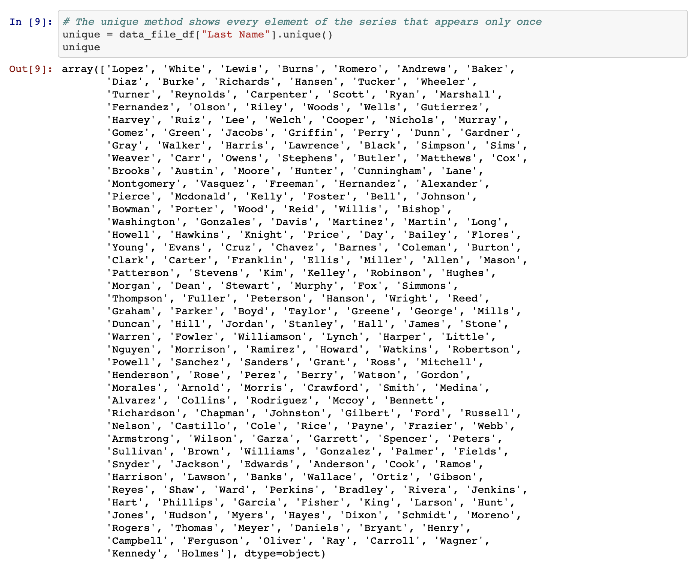
Built-In Function: unique()
There are situations where it is helpful to list out all of the unique values stored within a column. This is precisely what the unique() function does, by looking into a Series and returning all of the different values within.

Slide 28
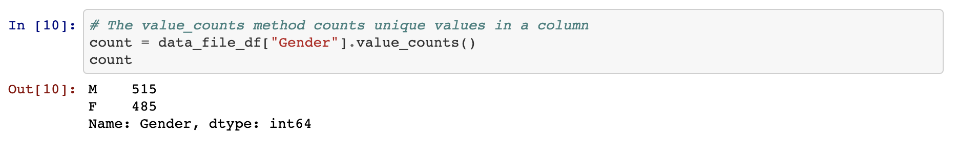
Built-in Function: value_counts()
Another method that holds similar functionality is value_counts(), which not only returns a list of all unique values within a series but also counts how many times a unique value appears.

Slide 29
DataFrame Functions

Slide 31
Activity: Training Grounds
In this activity, you will take a large DataFrame consisting of 200 rows, analyze it using some data functions, and then add a new column.
15 Minutes

Slide 32
Reading CSVs and Column Manipulation

Slide 33
If you are given data that is in an .xlsx or .csv format, how do you create a DataFrame?

Slide 34
You can import the xlsx file using using pd.read_excel().
And you can import the csv file using pd.read_csv().

Slide 35
Reading CSVs

Slide 36
Activity: GoodReads CSV
In this exercise, students will take a large CSV of books, read it into Jupyter Notebook using Pandas, and clean up the columns.
15 minutes

Slide 37
Activity: GoodReads CSV
Two things to keep in mind while working on this activity
1
2
The initial CSV file is encoded using UTF-8, so it should be read using this encoding as well to ensure there are no strange characters hidden within the dataset.
There are a lot of columns that are being modified within this code, so it is useful to get all the columns in an array using the .columns attribute. This helps to make sure that all references are made accurately so as to avoid any potential errors.

Slide 38
Merging DataFrames

Slide 39
Merging is the process of combining two tables based on shared data.

Slide 40

Merging DataFrames
Sometimes an analyst will receive data split across multiple tables and sources
Working across multiple tables is error prone and confusing
Shared data can be an identical column in both tables or a shared index
In Pandas, we can merge separate DataFrames using the pd.merge() method

Slide 41
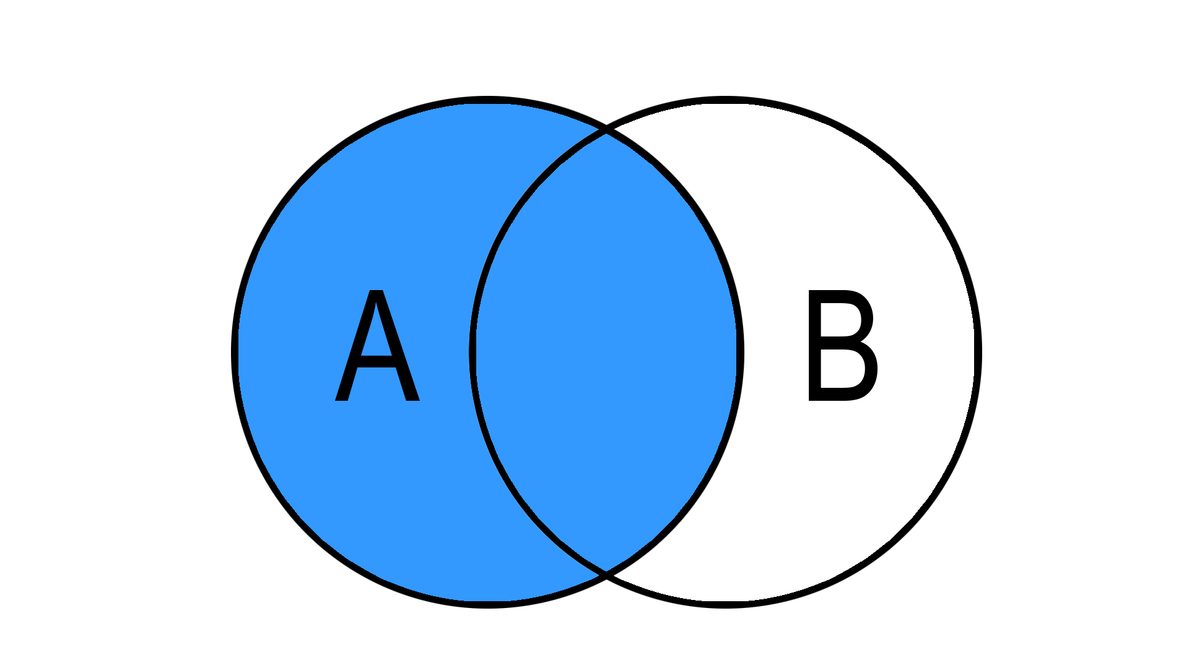
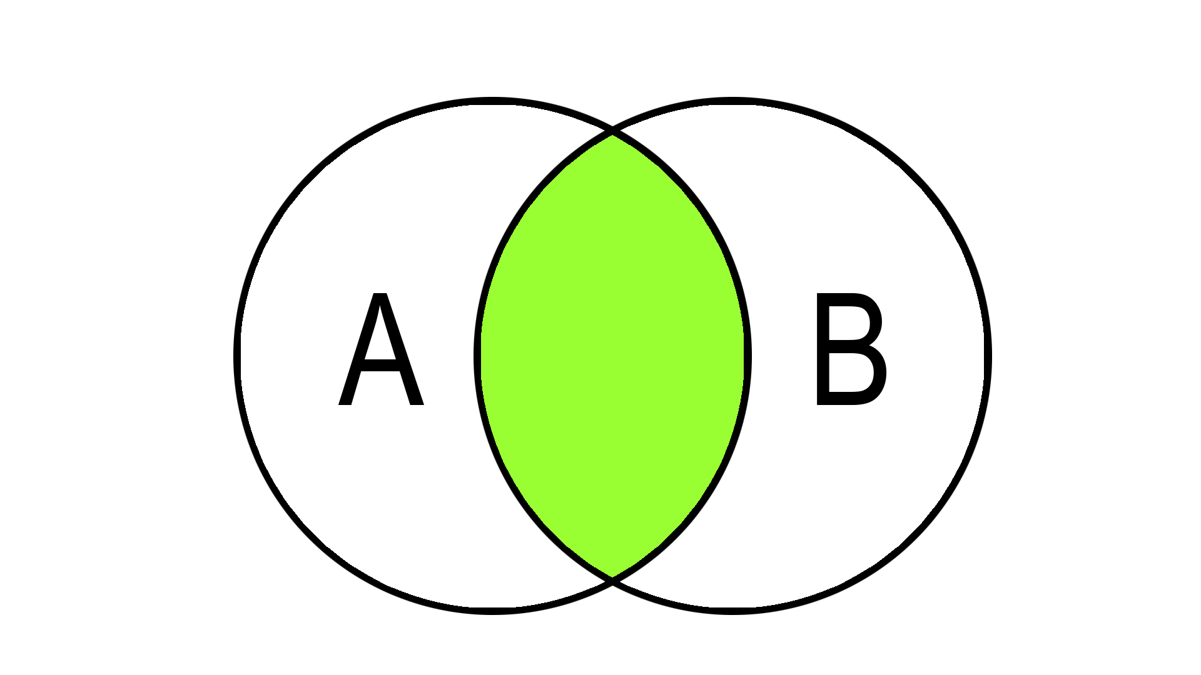
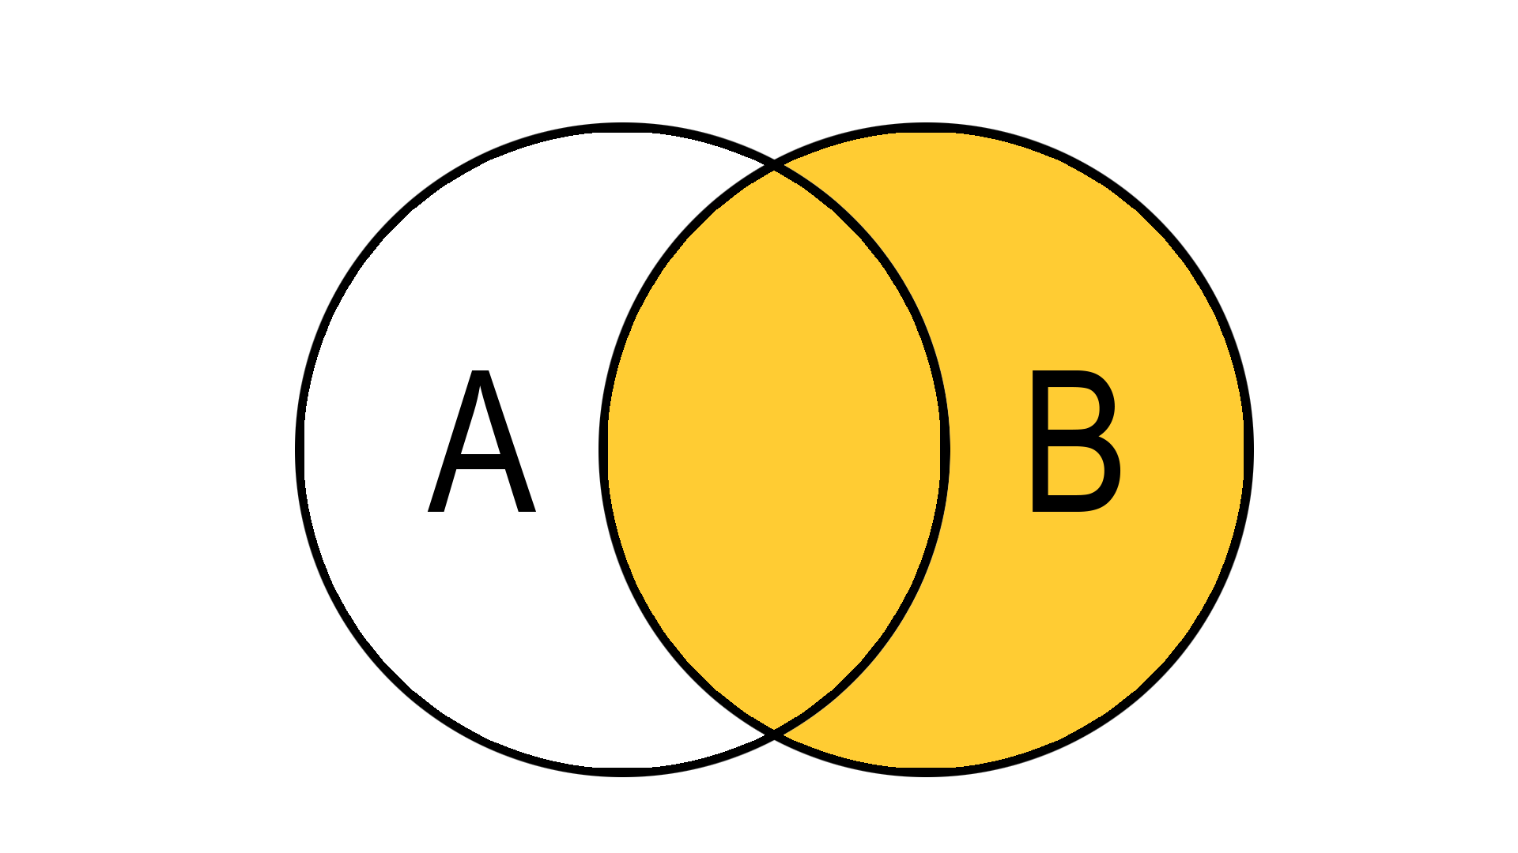
Joins Are VERY Important in Data Science!
When merging data tables, joins tell the program what data to keep. Besides outer joins, there are three other common joins:
Left Outer Join:
All rows from table A, even if they do not exist in table B
Inner Join:
Fetch the results that exist in both tables
Right Outer Join:
All rows from table B, even if they do not exist in table A

Slide 42
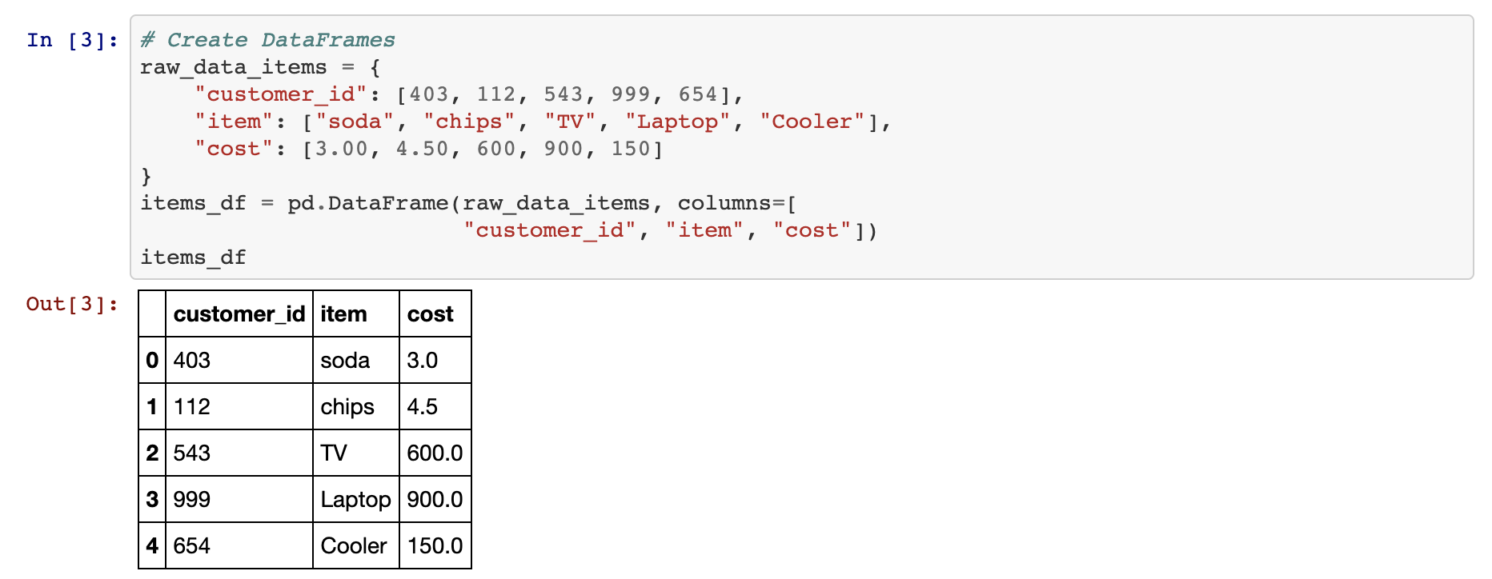
Merging DataFrames: Inner Join
Inner joins are the default means through which DataFrames are combined using the pd.merge() method and will only return data whose values match. Rows that do not include matching data will be dropped from the combined DataFrame.
Inner Join:
Fetch the results that exist in both tables

Slide 43
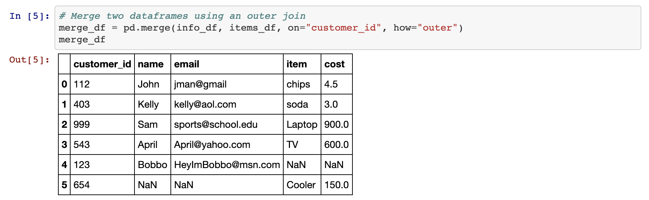
Merging DataFrames: Outer Join
Outer joins will combine the DataFrames regardless of whether any of the rows match and must be declared as a parameter within the pd.merge() method using the syntax how="outer".

Slide 44
Any rows that do not include matching data will have the values within replaced with NaN instead.

Slide 45
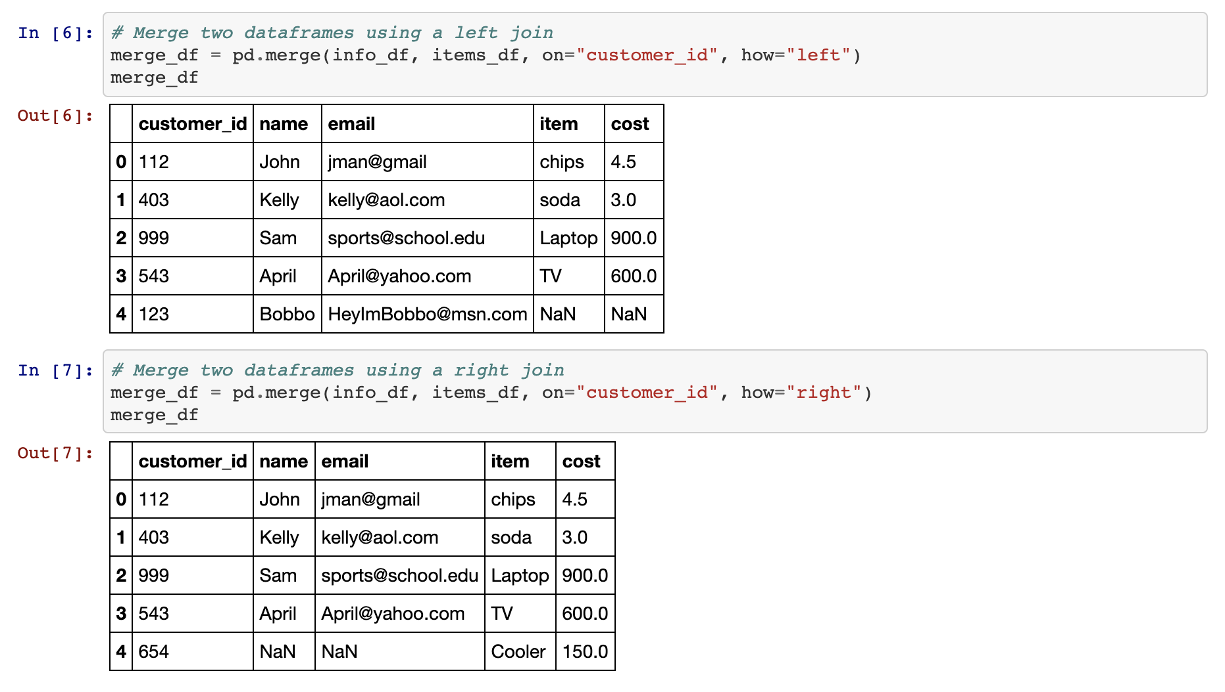
Merging DataFrames: Right and Left Joins
These joins will protect the data contained within one DataFrame, like an outer join does, while also dropping the rows with null data from the other DataFrame.

Slide 46
Merging Data

Slide 48
Formatting and Mapping

Slide 49
To format numbers in Pandas, we need to use the map() method to apply a string format function.

Slide 50
Formatting Syntax
The formatting syntax used for mapping is, in a word, confusing. It uses strings containing curly brackets in order to determine how to style columns and this can make it rather difficult to understand at first glance.
# Use Map to format all the columns
file_df["avg_cost"] = file_df["avg_cost"].map("${:.2f}".format)
file_df["population"] = file_df["population"].map("${:,}".format)
file_df["other"] = file_df["other"].map("${:.2f}".format)
file_df.head()

Slide 51
Formatting Syntax
A somewhat easy way to understand mapping strings is that it is almost akin to concatenating strings. Whatever is outside of the curly brackets is added before/after the initial value which is modified by whatever is contained within the curly brackets.
# Use Map to format all the columns
file_df["avg_cost"] = file_df["avg_cost"].map("${:.2f}".format)
file_df["population"] = file_df["population"].map("${:,}".format)
file_df["other"] = file_df["other"].map("${:.2f}".format)
file_df.head()

Slide 52
Formatting Syntax
So, to convert values into a typical dollar format, one would use "${:.2f}".
This places a dollar sign before the value which has been rounded to two decimal points.
# Use Map to format all the columns
file_df["avg_cost"] = file_df["avg_cost"].map("${:.2f}".format)
file_df["population"] = file_df["population"].map("${:,}".format)
file_df["other"] = file_df["other"].map("${:.2f}".format)
file_df.head()

Slide 53
Formatting Syntax
Using "{:,}" will split a number up so that it uses comma notation.
For example: the value `2000` would become `2,000` using this format string.
# Use Map to format all the columns
file_df["avg_cost"] = file_df["avg_cost"].map("${:.2f}".format)
file_df["population"] = file_df["population"].map("${:,}".format)
file_df["other"] = file_df["other"].map("${:.2f}".format)
file_df.head()

Slide 54
Formatting Syntax
Format mapping only really works once and will return errors if the same code is run multiple times without restarting the kernel. Because of this, formatting is usually applied near the end of an application.
# Mapping has changed the datatypes of the columns to strings
file_df.dtypes
id | int64
city | object
avg_cost | object
population | object
other | object
dtype: object | object

Slide 55
Format mapping also can change the datatype of a column. As such, all calculations should be handled before modifying the formatting.

Slide 56
Formatting and Mapping

Slide 58
Activity: Formatting and Mapping
In this exercise, you will read sales data into a DataFrame and are asked to format the columns that are int64 or float64 data types with comma notation, a dollar sign, and to two decimal places.
15 minutes

